Slide 1
OSINT: Constructing Google Search Queries
Subtitle: An Analysis of Cybersecurity Topics
Name: Nkemjika Godswill Nzubechi
Date: 10th October 2024

Slide 2
Introduction to OSINT and Search Queries
Purpose of the Research:
The goal of this project is to utilize complex Google search queries to conduct Open Source Intelligence (OSINT) investigations.
What is OSINT?:
OSINT refers to the process of collecting information from publicly available sources for intelligence purposes.
It is widely used in cybersecurity to gather insights on threats, vulnerabilities, and attacks.
Overview of Topics Covered:
Articles related to specific Advanced Persistent Threats (APTs).
Investigations into stalkerware designed for Android.
Ransomware targeting the Middle East region.
Security attacks on AWS cloud infrastructure.
Phishing campaigns led by cyber adversaries in Iran.
Zero-day vulnerabilities affecting Cisco products.

Slide 3
Query 1
Query: site: thehackernews.com stalkerware Android 2022..2023
Full Query: https://sites: thehackernews.com "Ravie Lakshmanan" "apt29"
Description: This query aims to find articles written by Ravie Lakshmanan specifically focusing on the APT29 group.

Slide 4
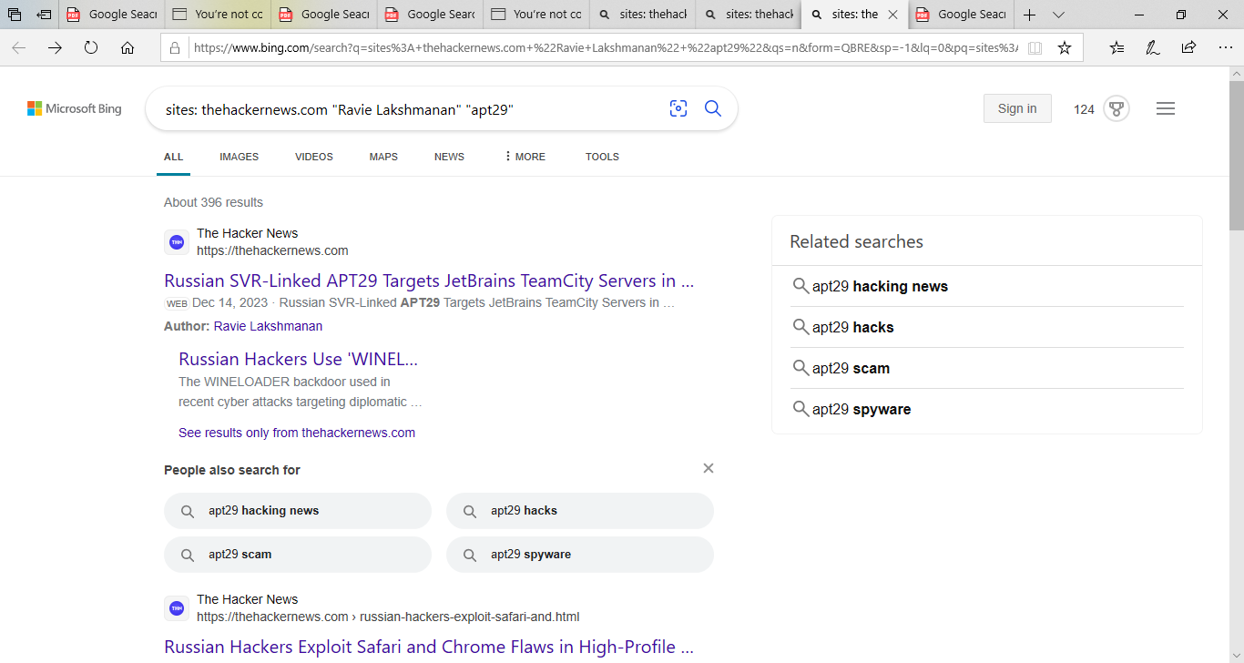
Query 1 Result from google search

Slide 5
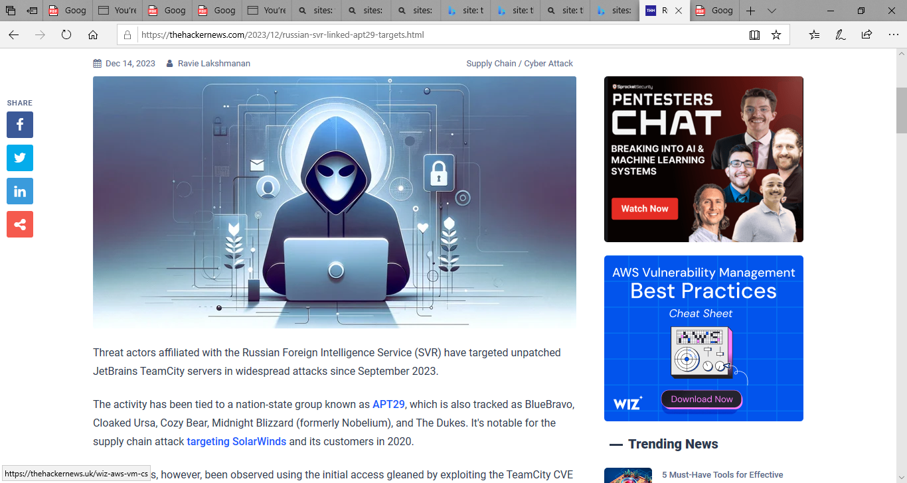
Article by Ravie Lakshmanan

Slide 6
Query 2
Query: site: thehackernews.com stalkerware Android 2022..2023
Purpose: To find articles on stalkerware related to Android published between 2022 and 2023.

Slide 7
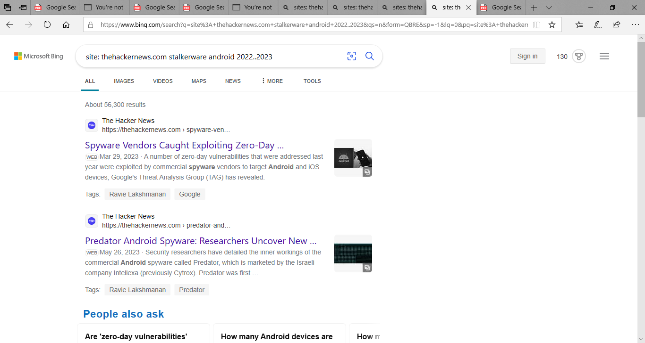
Query 2 result from google search

Slide 8
Query 3
Query: thehackernews.com ransomware "middle east" "linux" "last 6 months“
Purpose: To locate recent articles on ransomware affecting Linux systems in the Middle East.

Slide 9
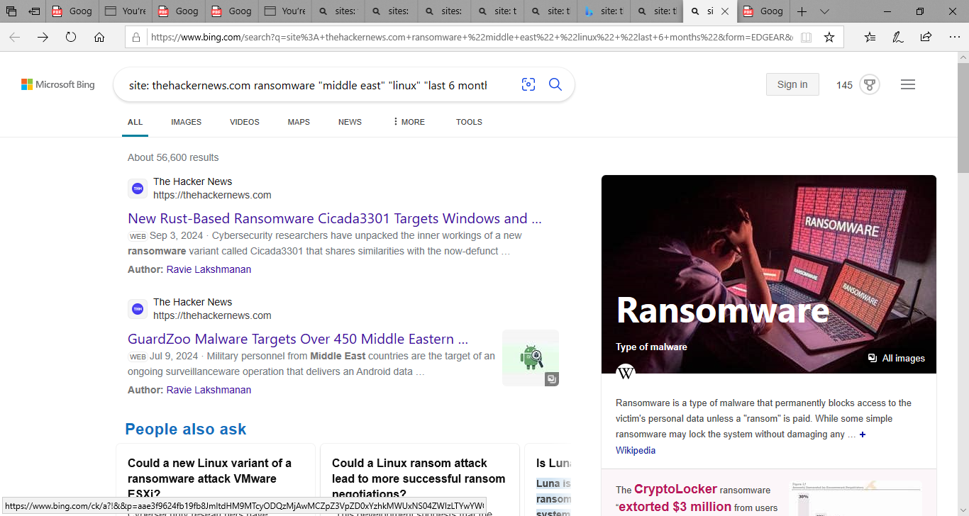
Query 3 result from google search

Slide 10
Query 4
Query: site: thehackernews.com "security attacks" "aws cloud" "iam service“
Purpose: To find articles discussing security attacks targeting AWS cloud IAM services.

Slide 11
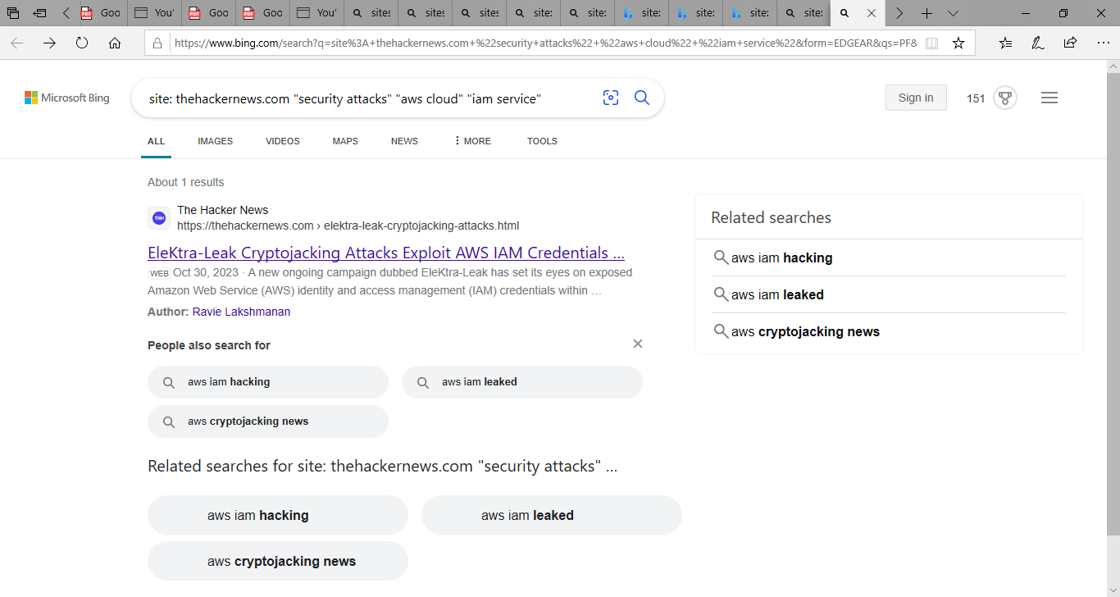
Query 4 result from google search

Slide 12
Query 5
Query: site: thehackernews.com "phishing" "spear phishing" "Iran" "documents" "lure victims“
Purpose: To search for articles on phishing attacks in Iran that use documents to lure victims.

Slide 13
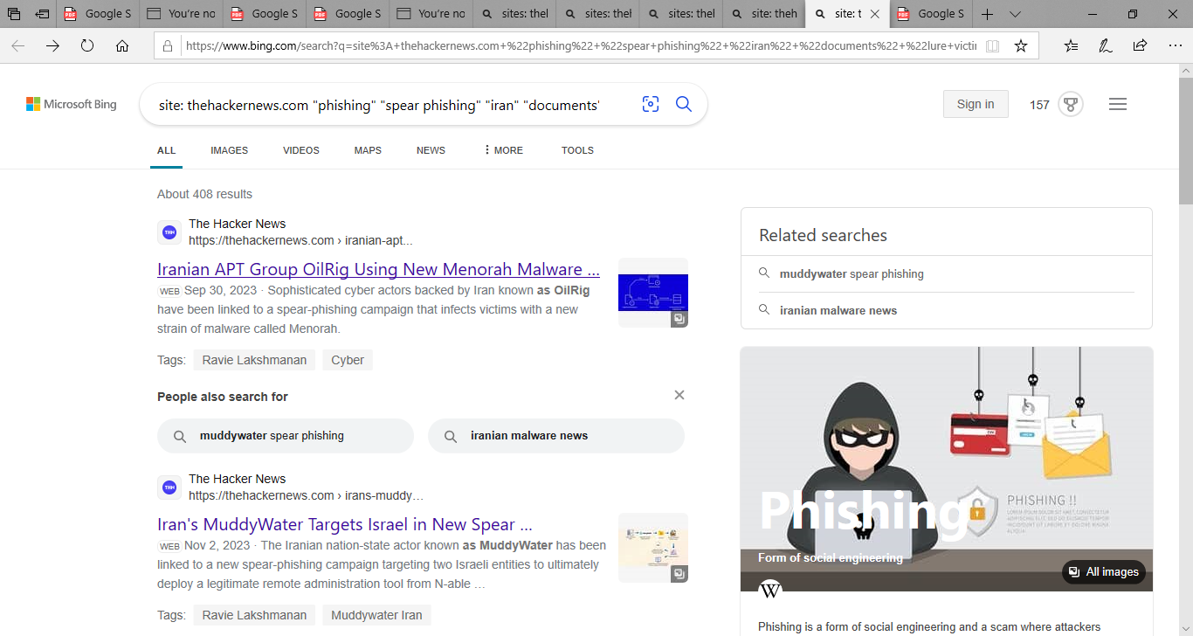
Query 5 result from google search

Slide 14
Query 6
Query: site: thehackernews.com "zero day vulnerability" "cisco network devices“
Purpose: To identify articles on zero-day vulnerabilities affecting Cisco network devices.

Slide 15
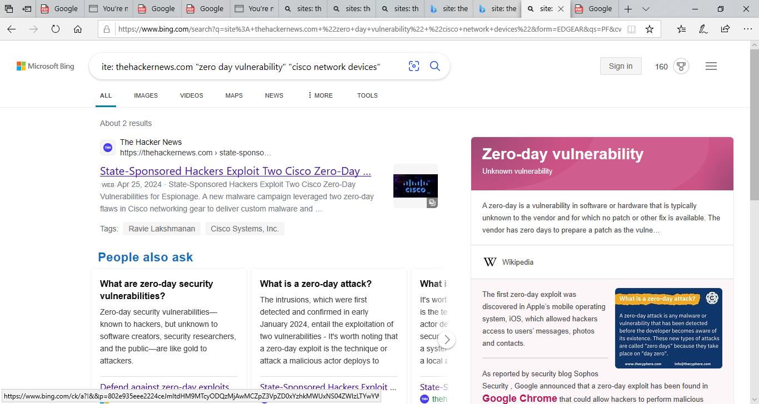
Query 6 result from google search

